Slide 1
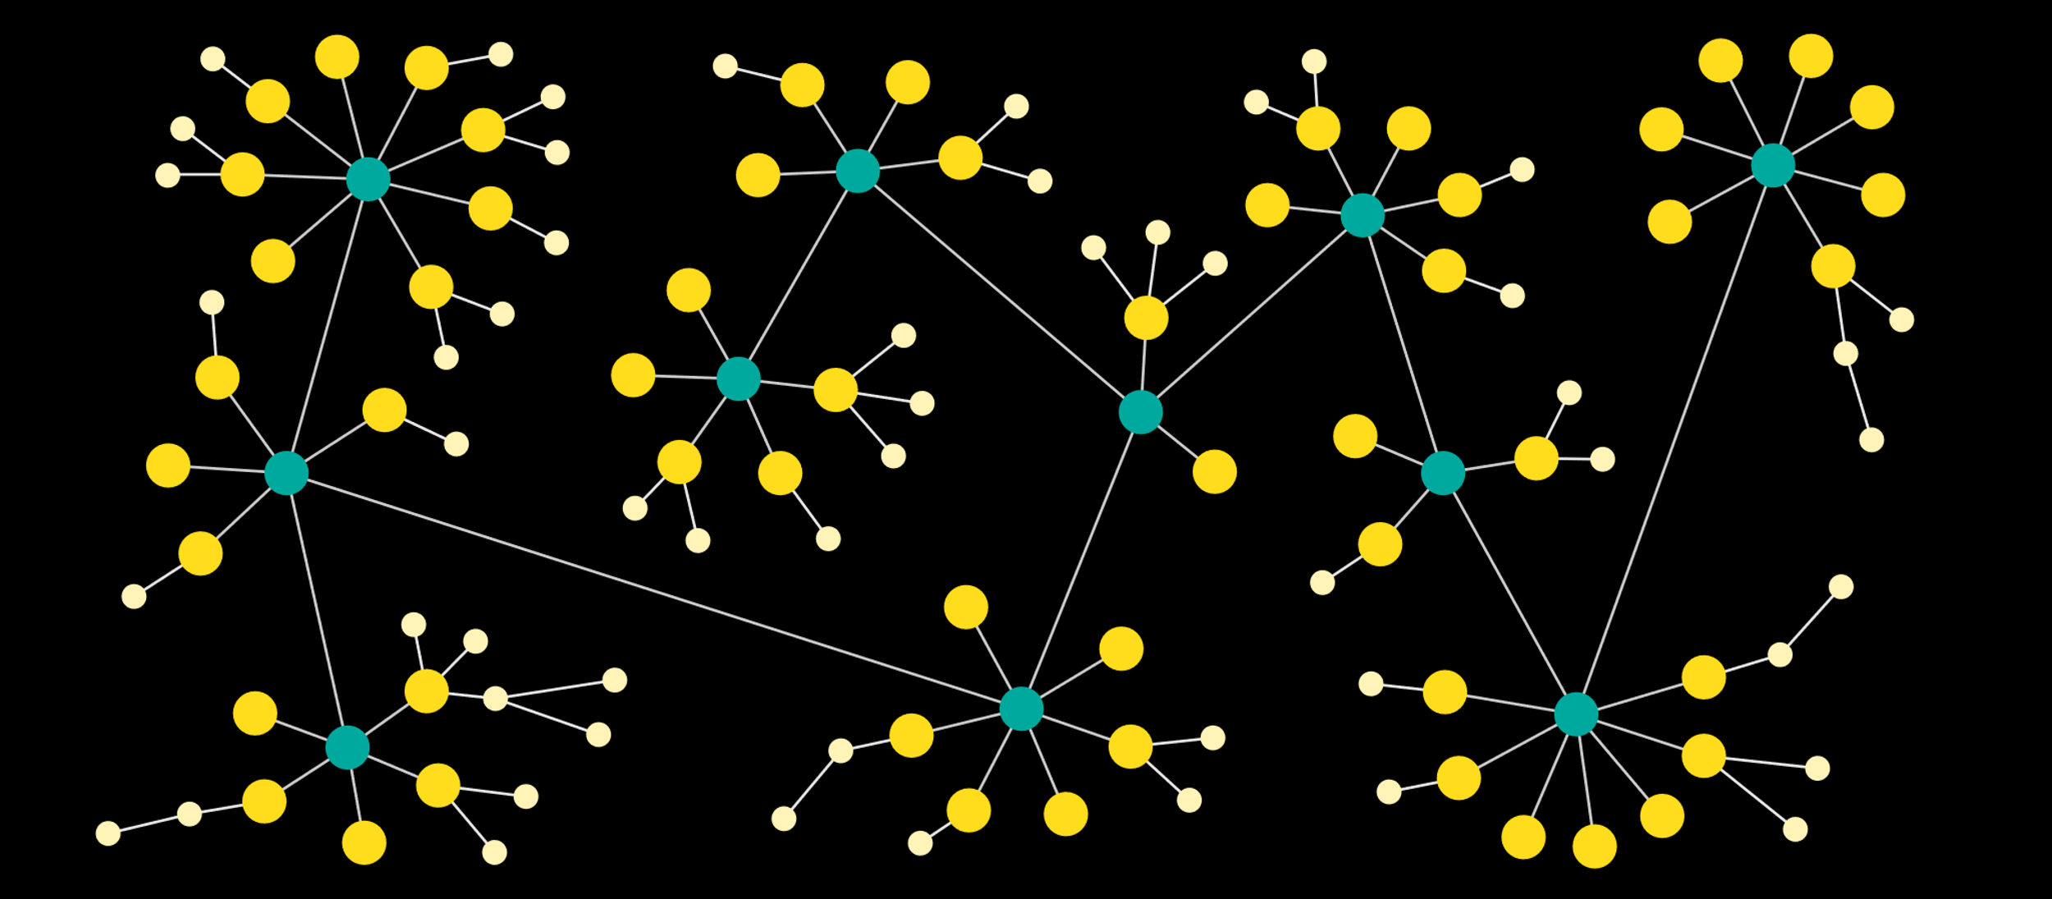
School-assessed coursework and exams
A connected approach to student preparation
Adele Hudson
ahudson@aitkencollege.edu.au
www.edudesign.com.au
Neural network
Reference: The data visualization catalogue

Slide 2
Neural network
Reference: The data visualization catalogue
Notes:
Why neural networks?

Slide 3
VCAA Science exams
Focus: Scientific literacy and experimental design
Connections
AOS
key knowledge descriptors
key science skills

Slide 4
Outline
VCAA exams: present and future directions
VCE exams through lens of an assessor: important skills
Benefits of mapping skills across Year 11 and 12
Designing SACs that mirror VCE standards
Preparing students for exams

Slide 5
Question: How do I prepare students for the challenges of my subject?
Answer: Use a connected approach and focus on skills.
Notes:
Use a connected approach and focus on skills.
Today I would like to focus on the skills that are embedded into the VCAA curriculum, SACs and exams that are transferable to Year 11 and middle school and more excitingly are beyond the focus of just attaining a high ATAR. I know that a high ATAR is the currency that many of our students and their families believe is highly important, however, this mode of learning to gain a number is starting to lose traction beyond the borders of school because it is recognized that it doesn’t necessarily serve students well in terms of readiness for University or the work place.

Slide 6
Question: How do I prepare students for the challenges of my subject?
Answer: Use a connected approach and focus on skills.
Moving beyond a focus on the ATAR

Slide 7
Overarching aim
Equitable education preparing students with skills for life.
Students will:
have multiple jobs and in an increasingly automated world
need a broader skill base with strong high order thinking skills
Resources
VCAA Advice for teachers
VCAA, Erin Wilson, Developing school-assessed coursework
Notes:
VCAA overarching aim: Equitable education preparing students with skills for life.
Students are entering into a world where they are more likely to have multiple jobs, they will coexist in a more automated world so they will need a broader focus to their skills with stronger foundations in high order thinking skills.
There is an understanding in the community of the importance of STEM and for STEM to be authentic learning. So how do we see this played out in the end of year exams?
Because what we measure or assess is what we value.

Slide 8
VCAA Science exams
Focus: Scientific literacy and experimental design
Connections
AOS
key knowledge descriptors
key science skills
High order thinking skills
Application
Analysis
Resources
VCAA 2019 Biology, Chemistry, Environmental Science, Physics and Psychology exams
Notes:
Since 2017 the VCAA science exams have moved towards 20% of the exam assessing key science skills and there is a dramatic shift towards requiring students to apply their knowledge in either case studies or practical applications.
The analysis questions I have defined in terms of Blooms and includes data and graphical analysis. Application questions are those where students are required to apply their knowledge to new contexts, while the key science questions are those where students are required to use key science skills. These questions often overlap the application and analysis questions as there is considerable overlap between all the areas.

Slide 9
Resources
VCAA 2019 Biology, Chemistry, Environmental Science, Physics and Psychology exams
Notes:
There are some interesting nuances between the four science subjects.
The Biology and Psychology exams both have a higher percentage of application type questions, with Chemistry have similar percentages of these types of questions and Physics having a higher analysis component due to many questions requiring graphical analysis. In terms of the extended response questions, all subjects require students to complete a question related to an experimental design and with Psychology having the holistic 10 mark question and Chemistry not far behind with a 9 mark question.

Slide 10
Future directions: Biology study design
Greater focus on key science skills, ethical approach and application of scientific knowledge
Resource
Oxford University Press, A teacher's guide to the new study design changes, www.oup.au, [date accessed 1st August 2020].
Notes:
And with the new study designs coming through, this shift towards key science skills, and big picture application type thinking will continue.

Slide 11
Question: So what can a connected approach look like?
Answer: Mapping skills across year levels
Unit 1 – 4 teaching teams
Map skills over Year 11 and 12
Map skills from 7 – 12 ???
Resource
Oxford University Press, A teacher's guide to the new study design changes, www.oup.au, [date accessed 1st August 2020].
Notes:
So what can a connected approach look like?
Unit 1 – 4 teaching teams
See ourselves as a Unit 1 – 4 teaching team
We could then map the skills over Year 11 and 12 as to where we will explicitly teach them.
A fun project would be to then to see how these skills could then be mapped to lower year levels.

Slide 12
Questions: What skills are important?
Observations from marking VCAA exams
Answer: high order thinking skills, key science skills and some surprisingly basic skills.
Notes:
Question: What skills are important?

Slide 13
2019 Science examiner report tips
Application Questions Provide answers relevant to the scenario or context. Do not use generic answers from textbooks, previous exams, or commercially produced reference sheets. Answering questions Use logical approach to answering questions. e.g. What is ________? Justify your answer. 1. Give answer. 2. Justify response. Do not restate the stem in the question Identify the intent of the question from the command terms. Spell key terms correctly. | Calculations; practise unit conversions e.g. g to kg. significant figures. apply and use of formulas. the use of correct units. Interpreting graphs Read labels, titles, and legend. Identify the variables, units and scale from axes. Identify, low and high points, turning points, shape of graph. Identify trends. Key Science Skills: know how to write conclusions. difference between systematic and random errors. how to use terms: accuracy, precision, validity, reliability, reproducibility, and uncertainty.
Resource: VCAA Biology, Chemistry, Environmental Science, Physics and Psychology 2019 examiners report
Notes:
After completing a review of the 2019 examiner’s reports there are similar themes that come through.
I would say that these are certainly things that I observed during marking which I have then used to change my teaching.
Students find applying their knowledge to new contexts to be challenging – this has helped me be more explicit about how to apply their knowledge. It is not enough to just give them practise questions, I have found that I have had to step through how to do this.
Students need to be taught how to follow a logical approach to answering a question.
Basic (but not necessarily easy) skills can bring students undone – I now uses quizzes throughout the year to give students opportunity to practise.
Interpreting graphs and drawing graphs is hard for students – I used to assume that they mastered this skill in maths, but the day I saw students joining the dots when they were inserting the trendline I realised that this was not the case.
Students find the key science skills hard which is because they are hard. And yes, I found out the hard way that you can’t teach key science skills in the last two weeks of term.
Students need to be able to remember something in order to put pen to paper. This was the most surprising idea. I had focused so hard on students being able to apply their knowledge I forgot to teach them to value remembering information.

Slide 14
Questions: What skills are important?
Blooms
remember, understand, apply, analyse, evaluate, create
Teach students
  how to remember not just what to remember
  how to apply their knowledge to another situation
  how to analyse and interpret graphs
Evaluate
Analyse
Create
Apply
Understand
Remember
Notes:
Valuing information as seen in this representation of Blooms taxonomy is really the foundation of all higher level knowledge.
Taking the time to teach students strategies to remember ideas as well as teaching them to value remembering ideas.
Then showing students how to transform their knowledge so that they can apply their knowledge.

Slide 15
Questions: What skills are important?
Command terms
Remember | Understand | Apply | Analyse | Evaluate
Define Find Identify List Name Recall State What | Calculate Describe Explain Give reasons Illustrate Outline Show Summarise | Apply Model Solve Transform Use Refer to | Analyse Classify Compare Conclude Distinguish Examine Explore Reflect | Evaluate Importance Interpret Judge Justify Opinion Recommend Select
Notes:
Teaching students the meaning of the command terms is integral to students being able to understand how to answer a question

Slide 16
What skills are important?
Key Science Skills
Planning and designing investigations
Sampling and experimental design
Variables
Hypotheses
Representing data
Summarising and reporting data
Error analysis and modifications
Writing conclusions
Resource: VCAA Biology, Chemistry, Environmental Science, Physics and Psychology study design
Notes:
And as I mentioned, explicitly teaching and embedding key science skills into learning activities throughout Units 1 – 4 makes such a difference for when you are preparing students for exams.

Slide 17
Mapping skills across Year 11 and 12: example Physics
U1AOS1 | U1AOS2 | U1AOS3 | U2AOS1 | U2AOS2 | U2AOS3 | U3AOS1 | U3AOS2 | U3AOS3 | U4AOS1 | U4AOS2 | U4AOS3
How can thermal effects be explained? | How do electric circuits work? | What is matter and how is it formed? | How can motion be described and explained? | Options | Practical investigation | How do things move without contact? | How are fields used to move electrical energy? | How fast can things go? | How can waves explain the behaivour of light? | How are light and matter similar? | Practical investigation
Unit conversion Use formulae Graphs Error analysis Write conclusions | Unit conversion Use formulae Summarise & report data Graphs | Scientific notation Unit conversion Use formulae Application Questions | Significant figures Use formulae Unit conversion Error analysis Writing conclusion | Application questions | Planning and design Variables Hypotheses Graphs Summarise data Error analysis Modifications Write conclusions | Unit conversion Scientific notation Use formulae Graphs Application questions Error analysis Modifications | Unit conversion Scientific notation Use formulae Graphs Application questions Writing conclusions | Unit conversion Use formulae Graphs Application questions Variables Hypotheses | Unit conversion Use formulae Graphs Application questions Summarise data | Unit conversion Use formulae Graphs Application questions Error analysis Writing conclusions | Planning and design Variables Hypotheses Graphs Summarise data Error analysis Modifications Write conclusions
- Latent heat of fusion exp - Specific heat - 1st Law exp | - Ohm’s Law exp - Voltage drops in circuits | -Radioactive decay app -Teach scientific notation | -Significant figures - Force & mass experiment | - students select own option topic | - students investigate own research project | -Van der Graff generator -strength of magnetic field in a coil | -Faraday’s Law -Transformer operation | -circular motion experiment -frames of reference | -interference of sound | -diffraction of light -photoelectric effect | -students investigate own project
Ssummary report of practical investigations | Transducer investigation, design, explanation of a device | Standard model investigation: report of physics phenomenon | Mousetrap car investigation, design, build, test, evaluate device | Reflective learning journal/blog to selected activities | Practical investigation | Data analysis | Annotations of two practical activities | A report of a physics phenomenon | A response to structured questions based on two scenarios | Data analysis including data plotting, error bars, and conclusions | Practical investigation
Notes:
This is an example of how you can map skills across Year 11 and 12.
I am currently teaching Year 11 Physics and I work closely with the Year 12 Physics teacher in terms of what and when we should introduce new skills. These skills are then embedded into learning tasks and SACs.

Slide 18
Designing SACs that mirror VCE standards
"Aim is for a suite of SAC tasks across each unit so students can demonstrate in different contexts and modes, knowledge, skills, understanding and capacities set out in the study design"
Resources
VCAA Advice for teachers
VCAA, Erin Wilson, Developing school-assessed coursework
Notes:
VCAA completed a whole range of presentations at the VCE conferences talking about what the were finding from their school audits and what their aims are.
Erin’s Wilson’s powerpoint is uploaded on the internet and although it was presented at the Psychology conference it is very much applicable to all subjects.

Slide 19
VCAA assessment principles | Purpose
valid and reasonable equitable balanced efficient | measure of achievement provide feedback on progress contributes evidence for satisfactory achievement of outcome
Resources
VCAA Advice for teachers
VCAA, Erin Wilson, Developing school-assessed coursework

Slide 20
Good SAC design
selected from VCAA options reflects VCAA outcome and task requirements unique to school and year level multiple entry points 20-50-25 level of difficulty student work is authenticated evaluated by colleagues
Resources
VCAA Advice for teachers
VCAA, Erin Wilson, Developing school-assessed coursework

Slide 21
Common SAC design errors
attempts to measure the entire outcome all tasks thinly veiled ‘set of structured questions’, not measuring key science skills commercially produced with minimal changes includes VCAA exam questions requires substantially more or less than allowed time marking guide does not add up to (or can be divided into) the outcome score, causing rounding errors
Resources
VCAA Advice for teachers
VCAA, Erin Wilson, Developing school-assessed coursework

Slide 22
VCAA future directions: Biology SAC options
-no ‘structured test’ , each task can only be selected once
Unit 1&2 | Unit 3&4
10 SAC options | Select one option for each area of study case study analysis & evaluation data analysis & evaluation comparison & evaluation of 3 prac investigations ethical analysis & evaluation Unit 4 AOS3 Poster & logbook entry
U3 SAC 20%, U4 SAC 30%, exam 50%
Resource
Oxford University Press, A teacher's guide to the new study design changes, www.oup.au, [date accessed 1st August 2020].
Notes:
I find I like to be prepared for any changes that are coming.
In the new Biology study design which will now be implemented at the start of 2022, there will be no structured tests and there is a requirement that no task be can repeated over the year.
The removal of the structured test option was also flagged at the Chemistry conference at the start of the year.
When I initially heard this my reaction was one of how am I going to prepare my students for the exam?
But then when I look at the options for the SACs, and after doing an analysis of the exam I can see that these tasks are more appropriate methods to prepare for the application, analysis and key science skills in the exam as these tasks require students to make links in their knowledge and key science skills while a structured test can be limited to measuring one idea at a time.

Slide 23
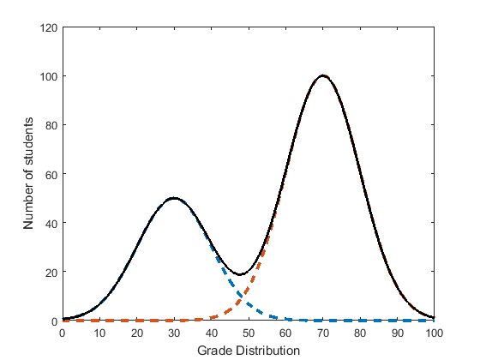
Designing 25-50-25 SACs
Notes:
One aim of the SAC is to allow students to demonstrate a range of achievements. One of the challenges I face in my subjects is that my tasks can tend to result in a bimodal spread of distributions. Where students who find the subject challenging do not have access to enough questions that they can answer.

Slide 24
Designing 25-50-25 SACs
LOT 25%
MOT 50%
HOT 25%
Marks: 30 | LOT: 25% 7 | MOT: 50% 15 | HOT: 25% 8 | KSS: 20% 6
Notes:
One strategy that I am now using is once I have decided on the type of task, the key knowledge descriptors, key skills and parts of the outcome that I will be assessing, I develop questions based using the division of questions that require low order thinking skills, middle order thinking skills and high order thinking skills.
I will also include key science skills into the task using the VCAA exam allocation of 20%.

Slide 25
Designing 25-50-25 SACs
Blooms Remember Understand Apply Analyse Evaluate Create
Low order thinking skills (LOT)
High order thinking skills (HOT)
SOLO Unistructural Multistructural Relational Extended
Abstract
Notes:
Being more targeted in my approach to developing questions in a SAC could help ensure more students demonstrate an understanding that they do have, while also ensuring students who have a solid understanding are still stretched.
In this diagram I have organised the different learning levels from Bloom’s and SOLO taxonomy from low order thinking skills to high order thinking skills.
Just as a recap, Blooms levels are remember, understand, apply, analyse, evaluate and create while SOLO the lower level is unistructural where students only have one idea, multistructural where they have multiple ideas, relational where they connect their ideas and extended abstract where to can make links beyond the current knowledge set.

Slide 26
Designing 25-50-25 SACs
Blooms Remember Understand Apply Analyse Evaluate Create
Low order thinking skills (LOT)
High order thinking skills (HOT)
Solo Unistructural Multistructural Relational Extended
Abstract
LOT 25%
MOT 50%
HOT 25%
Notes:
I then allocated these learning levels to low order thinking skills, middle order thinking skills and high order thinking skills.

Slide 27
Designing 25-50-25 SACs: Template
Science | Unit AOS | Outcome | Task
Qu | Thinking Process | Key knowledge/ Key Science Skill/ Outcome | SOLO | Blooms | Level
1
1a
1b
2a
Marks: | LOT: 25% | MOT: 50% | HOT: 25% | KSS: 20%
Notes:
I developed this template to build my SAC, where I identify the Unit, AOS, the outcome being measured, the type of task. And then for each question I describe the thinking process that the students will need to engage in in order to answer the question. The relevant KK, KSS and part of outcome, and then based on the thinking process I allocate SOLO, Bloom’s taxonomy and identify the level of thinking.
This would appear to be a lot of work when considering a structured test, however with the move towards more case study, stimuli type questions, there are often less questions, so it doesn’t take as long. Crafting the questions so that they enable students to demonstrate their understanding often takes the longest time.

Slide 28
Designing 25-50-25 SACs: Chemistry example
Chemistry | U4AOS2 | Outcome 2: Distinguish between the chemical structures of key food molecules, analyse the chemical reactions involved in the metabolism of the major components of food including the role of enzymes, and calculate the energy content of food using calorimetry. | Response to stimulus material: Students are presented with unfamiliar stimulus material related to food. Responses may take a variety of formats, but students should be required to identify and discuss key chemical concepts and to provide a personal perspective related any issues associated with the stimulus material as a measure of their scientific literacy.
Complete an essay plan for an evidence-based argument about whether you agree or disagree with the claim,
” Veganism and vegetarianism are better for a person’s health and the environment than a regular diet that includes meat.”
In your essay plan, compare plant-based diets with a regular diet that includes meat by: identifying the proportion and type of amino acids and fats in each diet, designing a flow chart showing the metabolism of proteins and fats in the human digestion system and the chemical reactions involved, including the role and importance of enzymes and comparing the energy content of a plant-based meal compared to a meal that includes meat.
.
Qu | Thinking Process | Key knowledge/ Key Skill | SOLO | Blooms | Level
-identifying the proportion and type of amino acids and fats in each diet. (3) | Recall Proteins- essential, non-essential, meat contains all essential amino acids while single plant only includes a few.(1) Fats – animal fats mostly saturated, plant fats are mostly unsaturated.(1) | distinction between essential and non-essential amino acids as dietary components chemical structures of saturated and unsaturated (monounsaturated and polyunsaturated) fatty acids | multistructural | Remember | LOT
-designing a flow chart showing the metabolism of proteins and fats in the human digestion system | Examples of information included in flow chart: Condensation reactions absorb energy to synthesise large macromolecules for storage (1). Proteins are stored in muscles, while fat is stored in adipose tissue. (1) |  | Relational | Understand | MOT
Marks Allocated: 30 | LOT: 30% 9 | MOT: 50% 15 | HOT: 20% 6 | KSS: 20% 6
Notes:
This is an example of a practise task that I have developed for Unit 3&4 Chemistry.

Slide 29
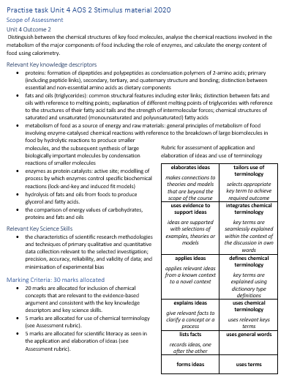
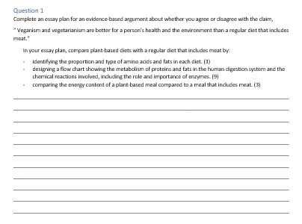
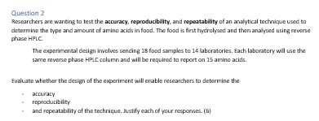
Notes:
This are just some screen shots of the overall task.

Slide 30
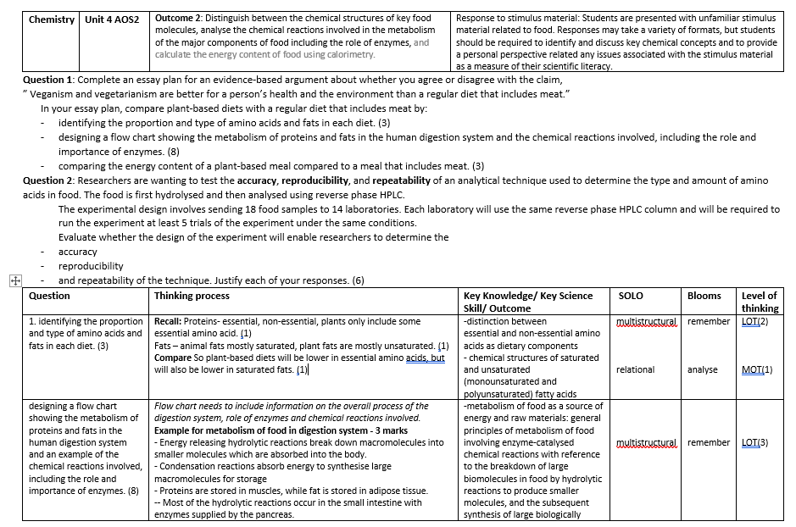
Notes:
And a section of the task showing how I used the template to identify the level of thinking required for each question.

Slide 31
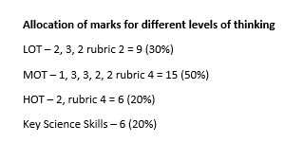
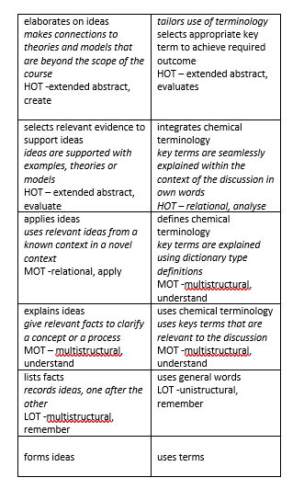
Notes:
And this is the final check as to the allocation of marks to the different levels of thinking.

Slide 32
Preparing students for exams
Challenges for students
Remembering content and processes
Process of answering questions
Application questions
Basic (not necessarily easy) skills
Key Science Skills
Notes:
In terms of preparing the students for exams, I have based these areas of challenge on those identified in the examiners reports for Science.
I have will highlight a few ideas around how remembering content, answering questions and application questions.

Slide 33
Remembering content
Teach students strategies for how to remember ideas – PEGS, association
Set content and processes as specific homework and use quizzes to measure understanding
Use flow charts or tables to help students find patterns
Notes:
As I mentioned earlier, it is important to teach students how to remember ideas, not just what they need to remember. Early on in the year you could focus on talking with the students about strategies that they can used to remember ideas, like PEGs or using association.

Slide 34
Process of answering questions
Underline key terms and stem of question
Teach students a logical process of answering question – model this
  answer first, then justify
Command terms –what type of question?
Plan answer and use dot points
Check answer for logic
Notes:
It is also important to step through with students how to answer questions in an exam. It is remarkable how students will forget to the underline the key terms and the stem of the question. It is worthwhile getting them to practise during class and to also practise following a logical process of answering a question and the use of a plan.

Slide 35
Application Questions
No answer | Answers are not relevant
Answers are generic | Answers are not concise
Notes:
With application questions there are a few approaches that I find. They either have no answer, the answers are not relevant, the answers are generic or the answers are not concise.

Slide 36
Application Questions
No answer - Identify the concepts they do and do not know Review ideas where they have no idea Run skill sessions for target group | Answers are not relevant
Answers are generic | Answers are not concise

Slide 37
Application Questions
No answer | Answers are not relevant - identify triggers to target relevant knowledge Use tables and flow charts to connect ideas List all content and identify relevant content for different contexts
Answers are generic | Answers are not concise

Slide 38
Application Questions
No answer | Answers are not relevant - identify triggers to target relevant knowledge Use tables and flow charts to connect ideas List all content and identify relevant content for different contexts
Answers are generic | Answers are not concise

Slide 39
Application Questions
No answer | Answers are not relevant
Answers are generic Find strategies for students to transform their knowledge. Reduce A4 content to A5 using dot points Identify key terms Use the same content to answer application questions in different contexts | Answers are not concise

Slide 40
Application Questions
No answer | Answers are not relevant
Answers are generic | Answers are not concise - Value concise answers - Teach students to plan before answering Show model answers Get students to mark wordy examples and rewrite as concise versions

Slide 41
School-assessed coursework and exams
A connected approach to student preparation
Adele Hudson
ahudson@aitkencollege.edu.au
www.edudesign.com.au
Neural network
Reference: The data visualization catalogue

