Slide 1

Streamlining Student Design Investigations
Jill Forward
Aitken College
www.edudesign.com.au
Contact: jforward@aitkencollege.edu.au

Slide 2
Student designed Investigations (SDIs)
Why are they important?
21st Century learning
VCE requirement
Inspire creative thought
Connecting students to real science

Slide 3
Systems for Conducting SDI’s
Research Groups
Individual practical requests
NAME : | CLASS:
TITLE :
VARIABLE that you are testing :
LAB EQUIPMENT | MATERIALS
PTO: Diagram to explain set up

Slide 4
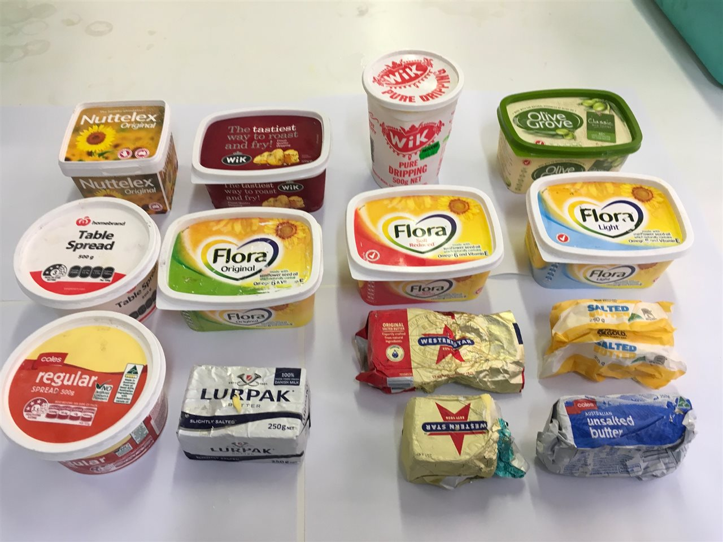
Systems for Conducting SDI’s
Individual Meetings with Teachers
Communal Base Trolley
Photos of available resources

Slide 5
Systems for Conducting SDI’s
Training of staff in techniques
Clear lines of accountability for teachers and Lab Techs
Lab technicians training students in techniques
Zones In Laboratory for streamlining cleanup and safety
Workflow in Prep Room

Slide 6
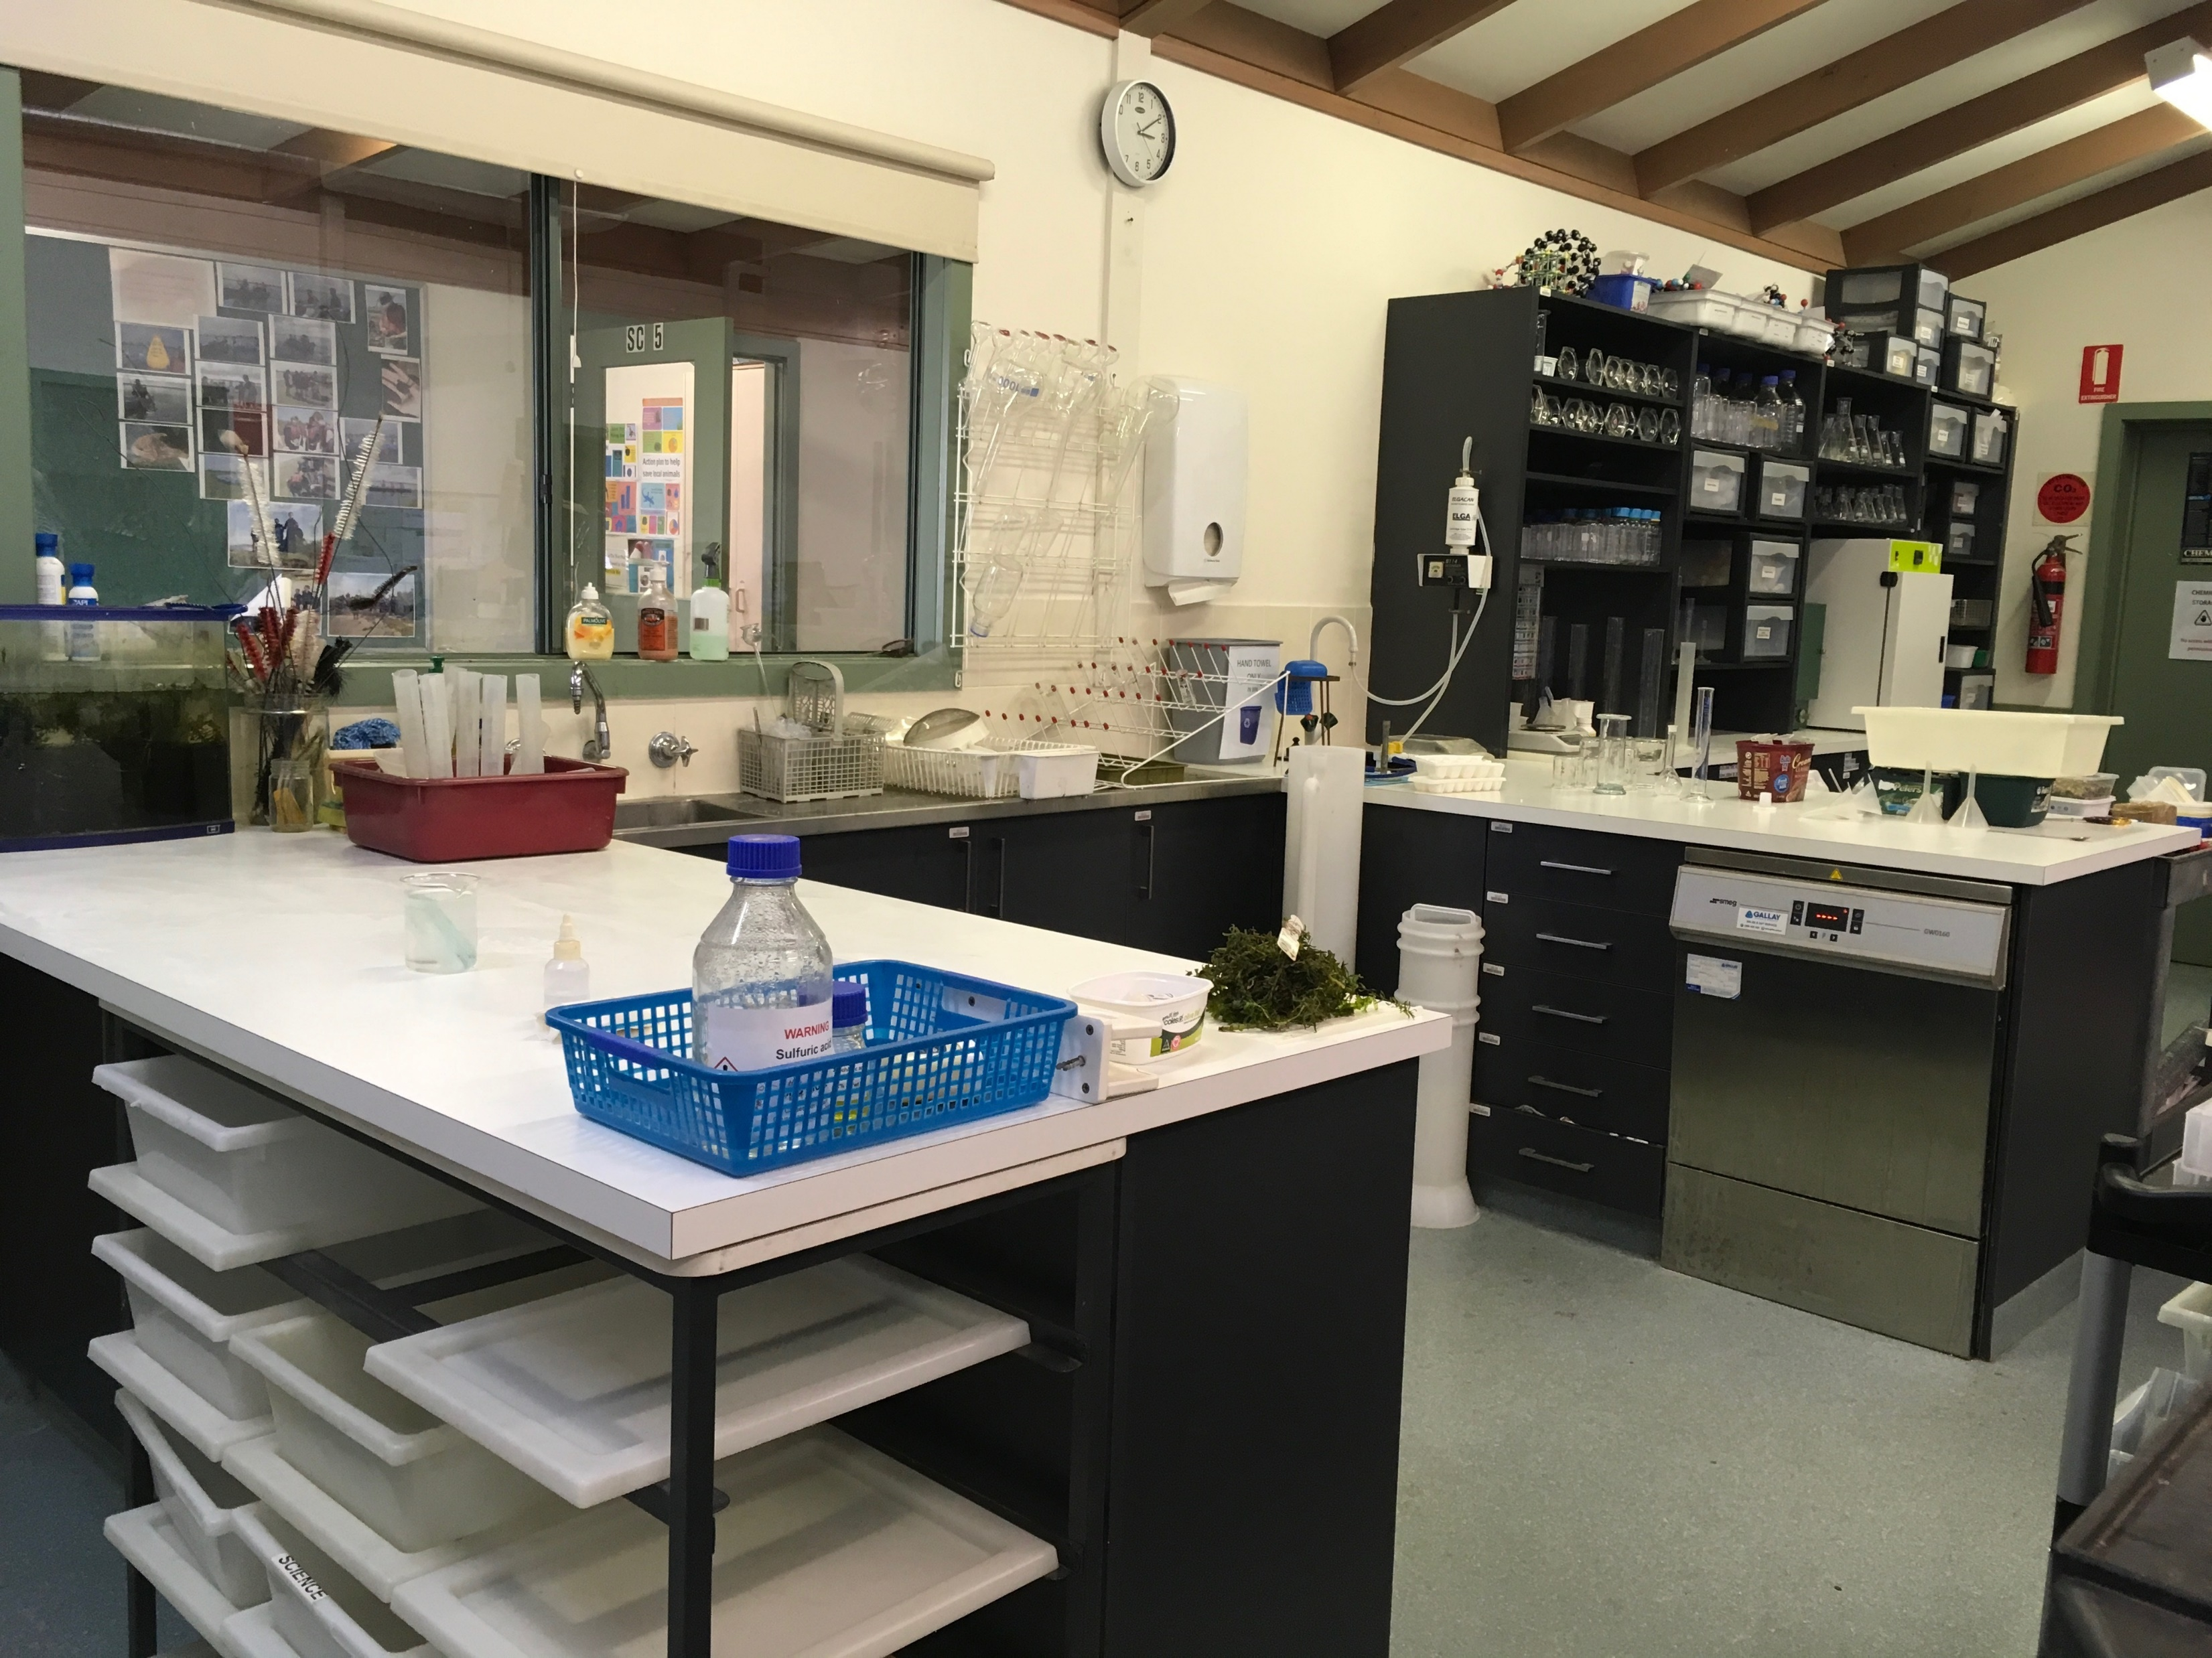

Slide 7
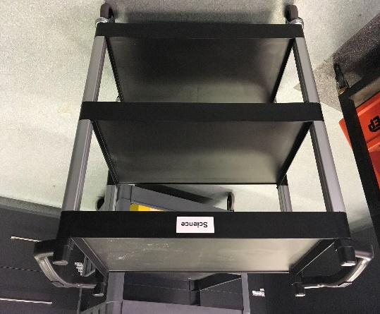
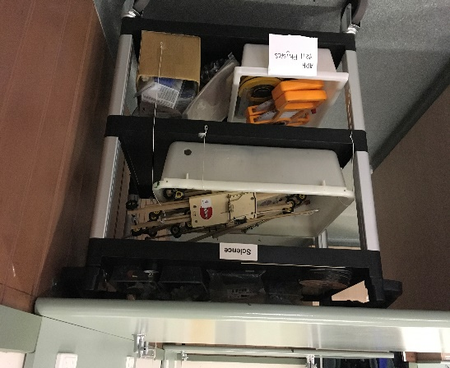
Systems for Conducting SDI’s
Lots of room for trolleys in Prep Room/classrooms.
Culture of being flexible and creative problem solving
Timetabling
Time and resources

Slide 8
Technique trials
Now it’s your turn
Colorimetry of elodea photosynthesis
Analysis of catalase activity using hydrogen peroxide
Reaction Rates using colorimetry
Compressibility of bioplastics

Slide 9
TROLLEY SUPPLIER
Brayco
www.Brayco.com.au
Polypropylene Trolley Small 83.5 x 41.3 x 96.6cm $119
BIOPLASTICS RESOURCE
https://issuu.com/nat_arc/docs/bioplastic_cook_book_3

Slide 10
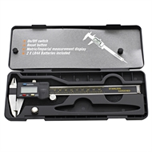
Digital Calipers
Bunnings
Craftright 150mm Digital Caliper
I/N: 5660742
$19.98 (2019)

Slide 11
Colorimeter, with multimeter from Haines
Item code: CO0101
Colorimeter, with multimeter
$110.00

